Slide 1


Introduction to
Robotic Process Automation
SWIGGY ORDERING BOT
220701077
A K Goutham
Mrs. J. Jinu Sophia(Ph.D.)
Assistant Professor (SG)
Department of Computer Science and Engineering

Slide 2
Abstract :
This project showcases the development of an automated bot designed to streamline the food-ordering process on the Swiggy platform. Built using Robotic Process Automation (RPA) tools like UiPath, the bot automates the entire workflow, from searching for specific dishes or restaurants to placing an order. The process begins by navigating to the Swiggy website and taking user inputs such as dish names, preferences (e.g., Veg or Non-Veg), and quantity. The bot performs actions such as searching for items, extracting structured data, filtering based on user preferences, adding selected items to the cart, and updating quantities. Finally, it proceeds to the checkout step, completing the order placement. This automation significantly reduces manual effort, enhances efficiency, and provides a seamless experience for users, demonstrating the potential of RPA in simplifying repetitive online tasks.

Slide 3
Need for the Proposed System:
The Swiggy Ordering Bot is a Robotic Process Automation (RPA)-based solution designed to simplify and streamline the food-ordering process on the Swiggy platform.
It automates tasks such as searching for dishes or restaurants, filtering results based on preferences (Veg/Non-Veg), adding items to the cart, updating quantities, and proceeding to checkout.
By taking user inputs like dish names and dietary preferences, the bot performs all actions with accuracy, consistency, and efficiency.
This system eliminates manual effort, saves time, and enhances user convenience, making it ideal for individuals, families, and businesses seeking to automate repetitive food-ordering tasks. It is a step towards leveraging automation to improve everyday digital experiences.

Slide 4
Advantages of the Proposed System:
Time-Saving: The bot automates the entire food-ordering process, from search to checkout, significantly reducing the time required compared to manual operation.
Enhanced User Convenience: Users can place orders without manually navigating through multiple menus or options, providing a hassle-free experience.
Accuracy and Error Reduction: The system ensures precise execution of tasks such as selecting items, filtering by preferences (e.g., Veg/Non-Veg), and updating quantities, minimizing human errors.
Scalability: Capable of handling multiple orders or bulk orders efficiently, the bot is ideal for both individual users and organizations.
Personalization: Customizable inputs allow users to tailor the bot’s actions based on specific requirements like preferred dishes, portion sizes, or dietary needs.

Slide 5
Literature Survey:
RPA is increasingly being utilized across industries for automating repetitive tasks,
improving efficiency, and reducing human error. The technology is applied in areas like
accounting, customer service, and e-commerce, often replacing manual workflows with
automated solutions. It leverages software bots that mimic human interactions on
interfaces, making it a low-code solution for non-technical users.
Advantages Identified:
Increased Efficiency: RPA tools operate 24/7 and execute tasks faster than humans, leading to significant time savings.
Error Reduction: Automating repetitive tasks minimizes the risk of human error, improving accuracy.
Scalability: RPA bots can scale up operations during peak times (e.g., processing bulk orders during festive sales).
Cost Savings: Once deployed, RPA reduces operational costs by minimizing reliance on manual labor.
Integration Without Infrastructure Changes: RPA can be implemented without altering existing IT infrastructure.

Slide 6
Literature Survey:
Disadvantages:
Fragility in Changing Environments: Bots relying on UI elements are sensitive to changes in web page design, requiring frequent updates.
Implementation Challenges: Setting up RPA requires careful planning to identify processes suitable for automation.
Limited Learning Capabilities: Traditional RPA lacks adaptability unless paired with AI or machine learning.
High Initial Investment: While RPA leads to savings over time, the initial setup can be costly for smaller businesses.

Slide 7
Main Objective:
The primary objective of the Swiggy Ordering Bot project is to automate the food ordering
process on the Swiggy platform by leveraging Robotic Process Automation (RPA).
This system is designed to:
Simplify the ordering process by automating repetitive tasks such as searching for restaurants, selecting dishes, filtering by preferences (Veg/Non-Veg), and placing orders.
Enhance user convenience by minimizing manual input and effort while ensuring accuracy and efficiency.
Provide a scalable and reliable solution for handling multiple or bulk orders seamlessly.
Save time and reduce errors by automating end-to-end operations, from browsing menus to checking out.
Offer a customizable experience where users can define preferences like dietary restrictions or quantity requirements, ensuring a tailored solution.

Slide 8
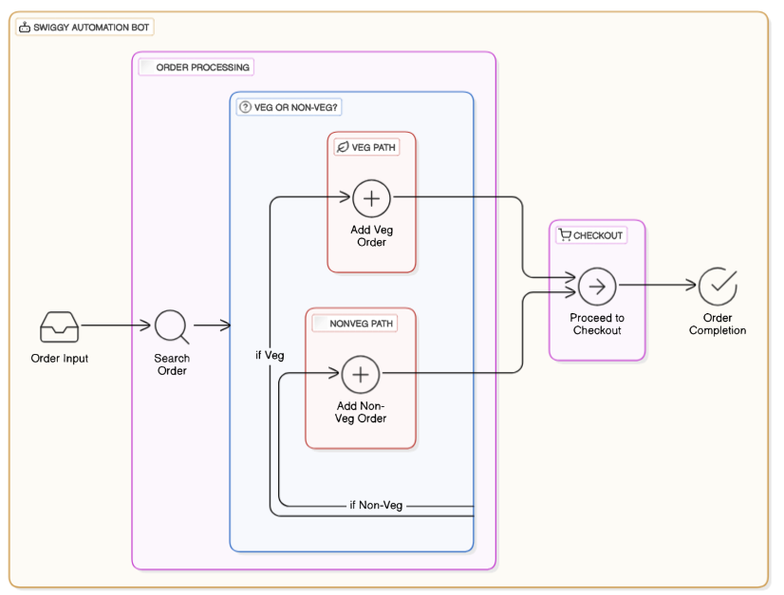
Architecture:

Slide 9
System Requirements:
Hardware Requirements:
Processor:
  Minimum: Intel Core i3 or equivalent.
  Recommended: Intel Core i5/i7 or equivalent for faster performance during automation tasks.
RAM:
  Minimum: 4 GB.
  Recommended: 8 GB or more to handle multitasking and smooth execution of RPA tools.
Storage:
  Minimum: 10 GB free disk space for software, logs, and temporary files.
  Recommended: Solid-State Drive (SSD) for better performance.
Input/Output Devices:
  Standard keyboard and mouse for bot setup.
  Internet connection (Broadband/Wi-Fi) with good speed (minimum 10 Mbps) for accessing the Swiggy platform.
Operating System:
  Windows 10 (64-bit) or higher.
  macOS (if using cross-platform RPA tools).

Slide 10
System Requirements:
Software Requirements:
Operating System:
  Windows 10/11 or macOS for compatibility with RPA tools.
RPA Tool:
  UiPath (preferred), Automation Anywhere, or Blue Prism for bot development and automation.
Web Browser:
  Google Chrome (latest version), Firefox, or Microsoft Edge for Swiggy interaction.

Slide 11
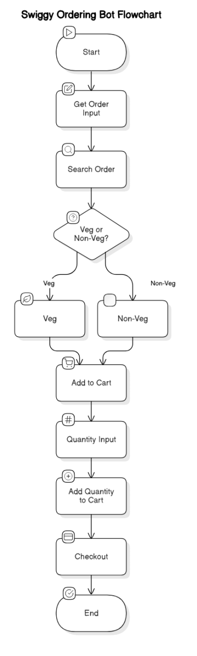
Functional Description :
Name of the Module:
"Web Automation Workflow for Food Ordering"
Description:
This module automates a food ordering process on a website. It performs tasks such as:
Opening a browser and navigating to the food ordering website.
Searching for restaurants or dishes based on user input.
Filtering options like "Veg" or "Non-Veg."
Adding items to the cart.
Proceeding to the checkout page.

Slide 12
Process Design:
1. Start
Open browser and navigate to the food ordering website.
2. Search
Prompt user for the dish/restaurant name and input it into the search bar.
Click Search to display results.
3. Filter
Prompt user to select "Veg" or "Non-Veg."
Apply the selected filter.
4. Add Items
Select an item, specify the quantity, and click Add to Cart.
Use a loop to allow adding more items.
5. Checkout
Navigate to the cart page, review items, and click Checkout.
6. End
Display confirmation and close the browser.

Slide 13
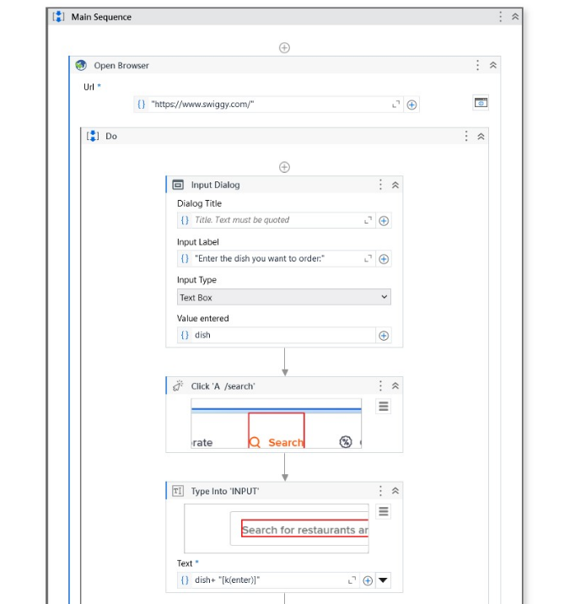
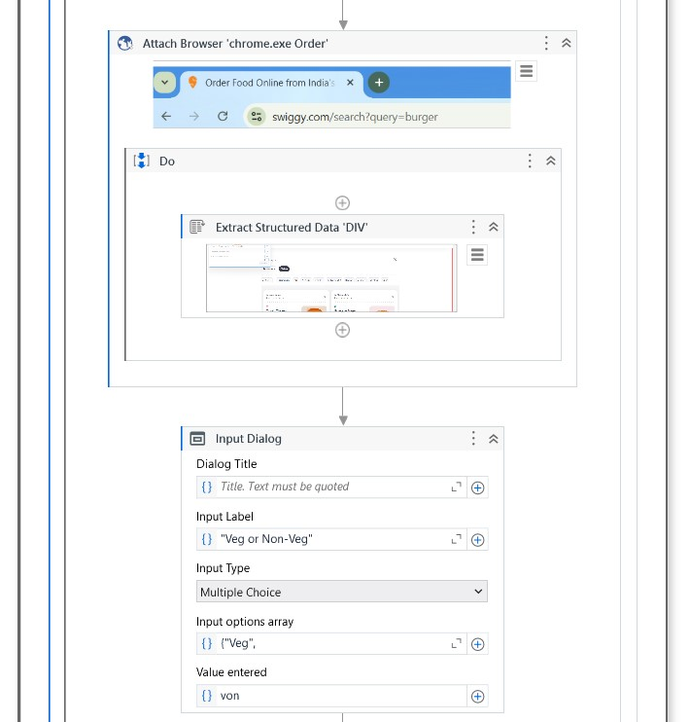
Implementation:

Slide 14
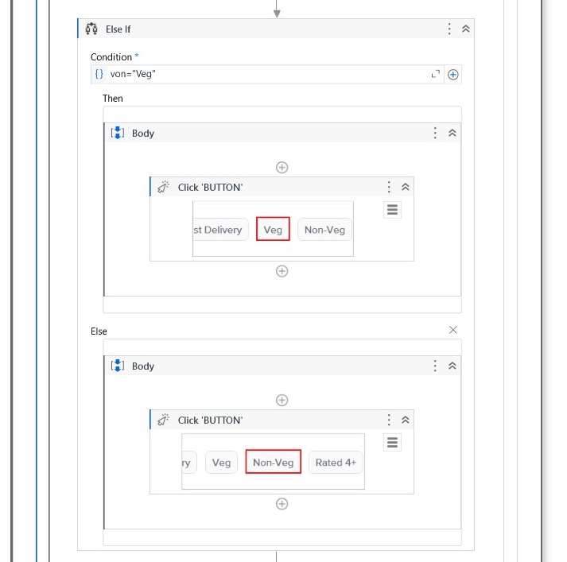
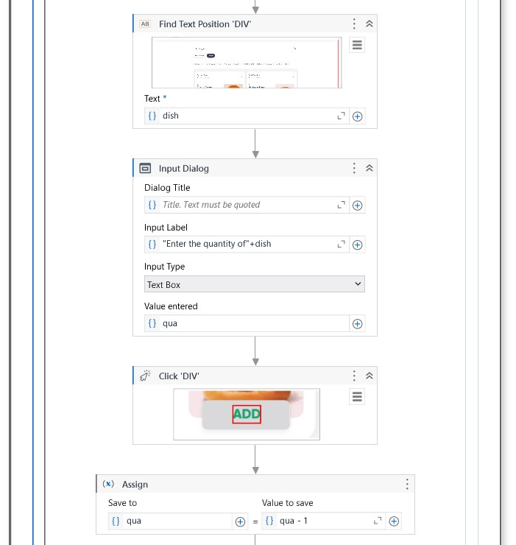
Implementation:

Slide 15
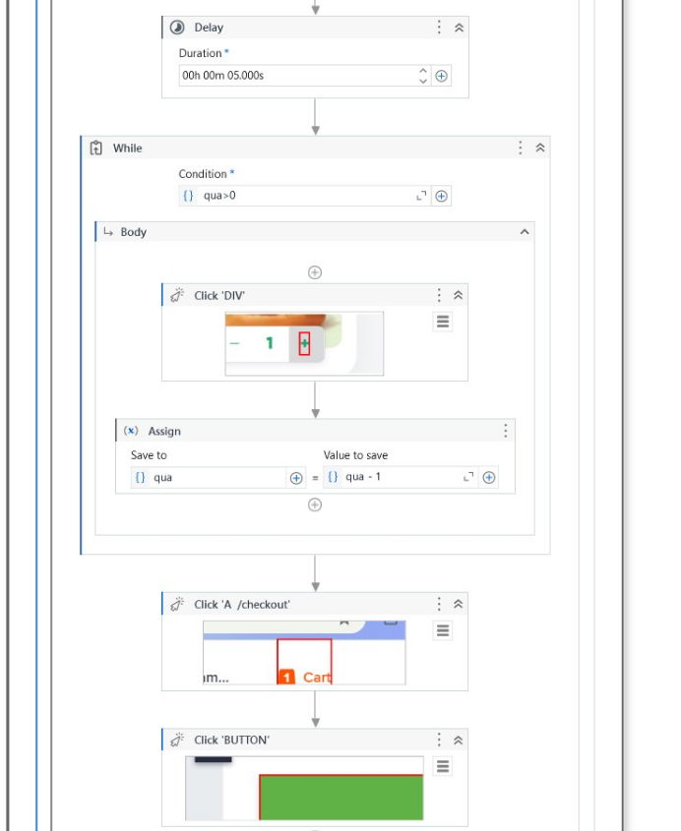
Implementation:

Slide 16
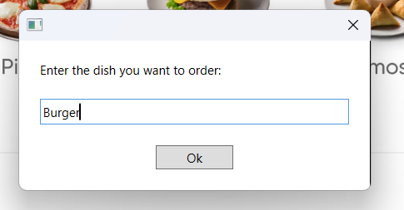
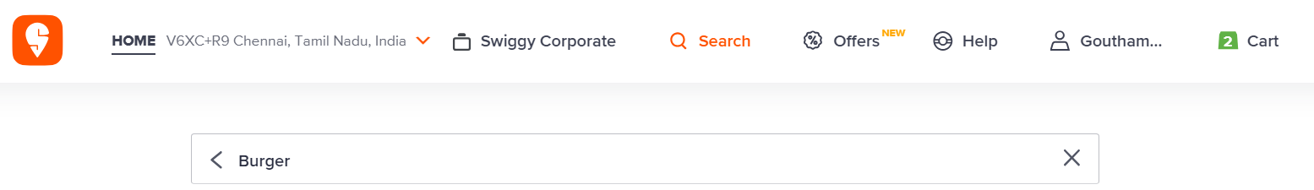
Testing:
Enter Input:
Search Order:

Slide 17
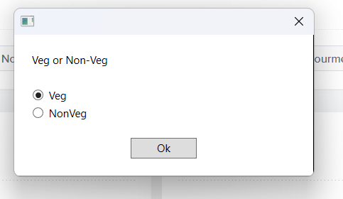
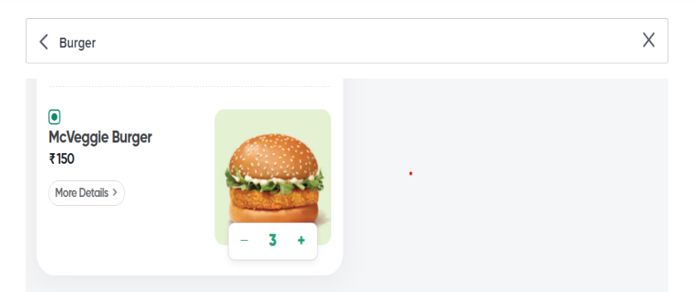
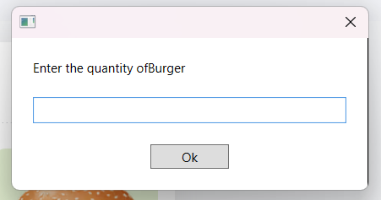
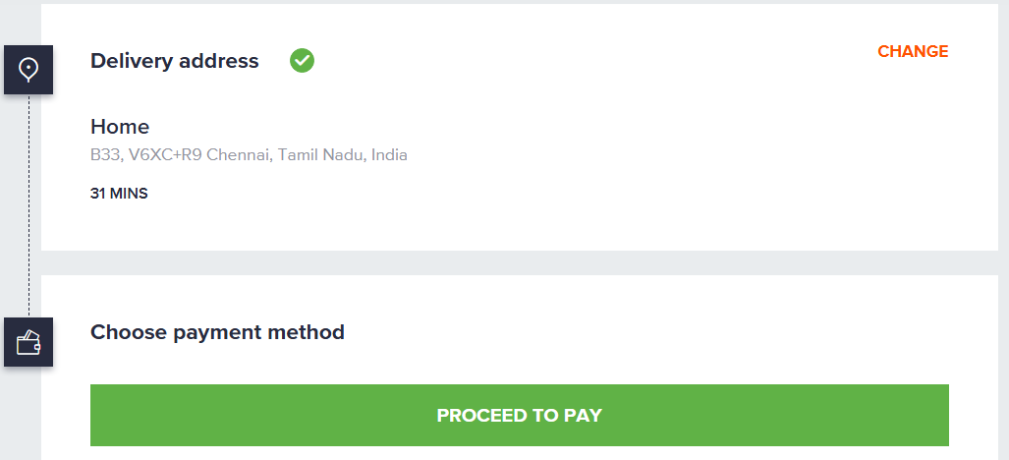
Choose Veg or Non-Veg:
Order Added:
Enter quantity:
Proceed to checkout:

Slide 18
Conclusions:
The project successfully demonstrates the potential of Robotic Process Automation (RPA) to streamline repetitive and time-consuming tasks, such as ordering items from a food delivery platform. By automating processes like searching for dishes, selecting preferences, and adding items to the cart, the workflow reduces human effort, minimizes errors, and enhances operational efficiency. The dynamic decision-making capabilities, such as Veg/Non-Veg selection, and the ability to handle user inputs make the automation adaptable and user-friendly

Slide 19
Future Enhancement:
Multi-Site Support
Automate ordering across multiple platforms (e.g., Zomato, Uber Eats).
Dynamic Inputs
Accept batch orders via file uploads (e.g., CSV/Excel).
Personalization
Integrate user preferences like dietary restrictions and favorite cuisines.
Error Handling
Advanced logging and retry logic for network/site failures.
Payment Integration
Automate secure payments via integrated gateways.
Real-Time Notifications
Send order updates via email, SMS, or WhatsApp.
AI-Powered Search
Enable conversational queries for seamless searching.
Scheduled Orders
Add support for scheduling future orders.

Slide 20
References
UiPath Official Website
Comprehensive guides, tutorials, and community forums.
https://www.uipath.com/resources
Automation Anywhere Blog
Articles on automation trends, best practices, and use cases.
https://www.automationanywhere.com/blog
Blue Prism Learning Resources
Resources to explore RPA concepts and implementations.
https://www.blueprism.com/resources/
Stack Overflow
A go-to platform for troubleshooting RPA workflows and code-related issues.
https://stackoverflow.com/
GitHub RPA Repositories
Open-source RPA scripts, projects, and tools.
https://github.com/topics/rpa

Slide 21
Queries

Slide 22
Demonstration

Slide 23
Thank You

